Slide 1
DineSys: Comprehensive Restaurant Management System
Final Project Presentation

Slide 2
Presenters
Vangala Ruchitha
Nikhila Polkampally
Nandhini Kasukurthi
Vishal Rachuri
Sai Srinivas Valleti
Chandralekha Gude
Aishwarya Karukonda
Hunny Keshwani
Leela Varadatta Sai Addanki

Slide 3
Introduction
The Project:
DineSys is a cutting-edge Restaurant Management System (RMS) designed to streamline operations and enhance the dining experience through technology.
The Importance of Technology in Modern Restaurant Management:
Efficiency: Automates routine tasks, reducing errors and saving time.
Customer Experience: Technology like DineSys offers personalized and faster service, leading to increased customer satisfaction.
Data-Driven Decisions: Provides valuable insights from data analytics to make informed business decisions.
Overview of the DineSys System:
Dual Interface: Tailored interfaces for staff and customers.
Key Modules: Includes order management, inventory control, human resources, and distributor management.
Technology-Driven: Utilizes PHP, MySQL, and modern front-end technologies for a robust and responsive system.

Slide 4
Team Members
Vangala Ruchitha: Team Leader, orchestrating project development and ensuring alignment with objectives.
Nikhila Polkampally: Backend Developer, responsible for the server-side logic and database management.
Nandhini Kasukurthi: Frontend Developer, crafting the user interface with a focus on user experience.
Vishal Rachuri: Quality Assurance, ensuring that the system meets quality standards through rigorous testing.
Sai Srinivas Valleti: System Analyst, handling system analysis and overseeing project documentation.
Chandralekha Gude: Project Coordinator, managing project workflow and feedback analysis.
Aishwarya Karukonda: HR and Staff Training Coordinator, managing team dynamics and staff training.
Hunny Keshwani: Backend Developer, assisting in database and server-side functionalities.
Leela Varadatta Sai Addanki: UI/UX Assistant, supporting the development of the user interface and enhancing user experience.

Slide 5
Project Overview
Overview of the DineSys System
High-Level Description:
DineSys is an integrated restaurant management system designed to enhance operational efficiency and customer service.
Combines various modules like order processing, inventory management, staff scheduling, and customer relationship management into one unified platform.
Key Objectives:
Streamlining Operations: Automating and simplifying day-to-day restaurant operations.
Enhancing Customer Experience: Reducing wait times and improving order accuracy.
Data-Driven Insights: Offering real-time analytics for informed decision-making.

Slide 6
Project Overview
Scope of the Project:
Comprehensive coverage of restaurant management aspects from front-end customer interactions to back-end administrative tasks.
Scalable design to cater to different sizes of restaurants, from small local eateries to large chains.
Target Audience:
Restaurants: Aiding in management and operational efficiency.
Staff: Empowering staff with tools for better service delivery and job satisfaction.
Customers: Enhancing the dining experience through technology.

Slide 7
Core Requirements:
This core requirements includes: Home interface, Administrator Interface, Chef’s Interface, Waiter’s interface, Accountant’s Interface and Table’s Interface.
Home interface will include:
Restaurant Logo.
Some of the dishes.
A Log In popup window.

Slide 8
Core Requirements
Administrator’s interface will include:
Worker button
Tables button
Add on menu button
Orders button
Log out button
All restaurant tables as buttons

Slide 9
Core Requirements
Chef’s interface will include:
Add new dish button
Log out button
A table where which row involves: table number, Order, Accept button , Done button.
Waiter’s interface will include:
Log Out button
Tables and Orders Buttons
A table with the confirmed orders until that moment. Options: Accept,Confirm,Print Receipt.

Slide 10
Core Requirements
A list of all the tables and their current status.
Accountant’s interface will include:
Log Out button
Employee Information Table
Product Information Table
Buttons: Suppliers, Create Transaction, See Transactions, Update Profile.

Slide 11
Implementation Details:
Technologies Used:
PHP:
Utilized for server-side scripting.
Chosen for its wide support, ease of integration with various databases, and strong backend capabilities.
MySQL:
Employed for database management.
Selected for its reliability, scalability, and compatibility with PHP.
JavaScript :
Used for creating dynamic and responsive user interfaces.
HTML/CSS:
Foundations for structuring and styling the frontend.
Ensures a responsive and visually appealing interface.
Frameworks and Libraries (e.g., jQuery, Bootstrap):
Enhance UI interactions and speed up frontend development.
Provide a consistent look and feel across the application.

Slide 12
Reasons for Choosing These Technologies:
Interoperability: These technologies work seamlessly together, providing a smooth integration of frontend and backend functionalities.
Community Support: Each technology has strong community support, ensuring access to a wealth of resources and troubleshooting assistance.
Scalability and Flexibility: The chosen stack allows for easy scalability and adaptability to evolving project requirements.

Slide 13
Structure:
High-Level Architecture of DineSys
Architecture Overview:
DineSys is structured as a multi-tiered application, comprising distinct but interconnected layers that handle various aspects of restaurant management.

Slide 14
Major Components:
Frontend:
Technology: Utilizes modern web technologies for responsive design.
Function: Serves as the user interface for both customers and staff, enabling interactions like order placement, viewing menus, and managing profiles.
Backend:
Technology: Built on PHP, ensuring robust server-side processing.
Function: Handles business logic, including order processing, staff scheduling, and inventory management. It is the core engine that processes data and requests from the frontend.
Database:
Technology: MySQL database for secure and efficient data storage.
Function: Stores all vital information such as user data, inventory details, order history, and staff records. It's optimized for quick data retrieval and updates.
API Layer:
Function: Facilitates communication between the frontend and backend. Also integrates with external systems like payment gateways and third-party services.
Security:
Implements comprehensive security measures at every layer to protect data and user privacy.

Slide 15
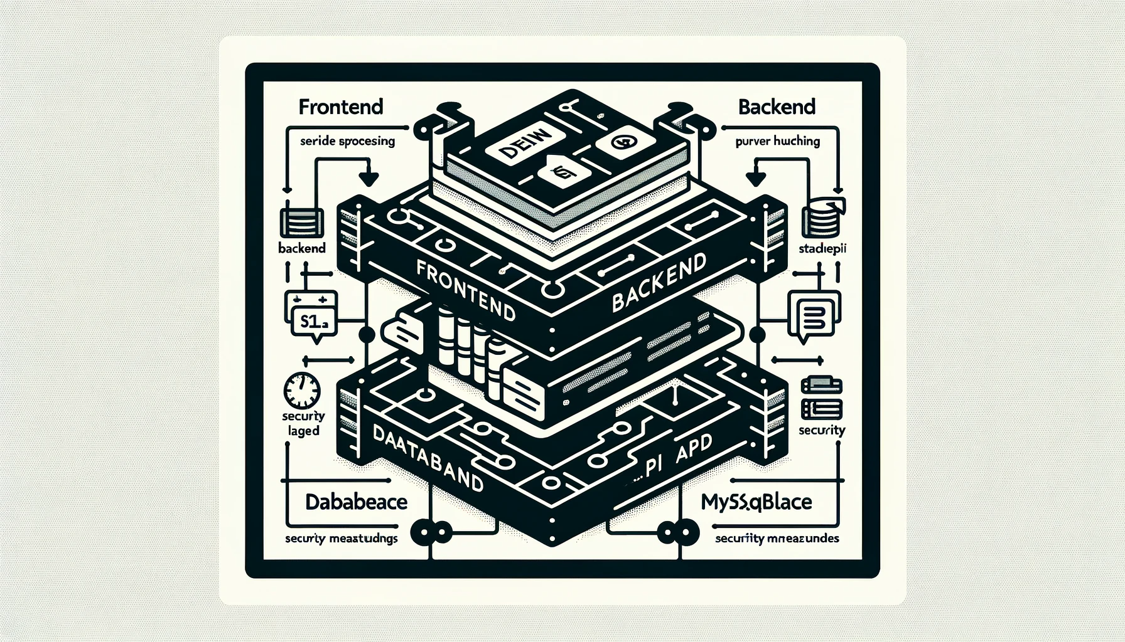

Slide 16
Testing and Quality Assurance

Slide 17
Approach to Testing in DineSys
Testing Methodologies:
Unit Testing:
Focused on individual components to ensure they function correctly in isolation.
Utilized PHPUnit for backend PHP components and Jasmine or Mocha for JavaScript testing.
System Testing:
End-to-end testing to validate the integrated system.
Covered all functionalities across different user roles and scenarios.
Automated Regression Testing:
Automated tests run after every major update to ensure new changes don’t disrupt existing functionalities.
Usability Testing:
Conducted with real users to evaluate the system's ease of use and overall user experience.

Slide 18
Feedback from peer review
Mean Green makes the following recommendations: 1. Maintaining and protecting client data. 2. Managing phony promotional codes 3. Customer-side tip personalization 4. Order cancellation within a set time following placement; the customer may be able to change the quantity but not necessarily the goods.
Things from Team Mean Green that our team accepted: The Mean Green crew made 1, 2, and we accepted them and got to work on them.

Slide 19
Feedback from peer review
The Mean Green Team's rejected ideas are as follows: The team also provided suggestions about authentication, but we are rejecting those as well. We have already incorporated suggestions 3 and 4 into our project.
Feedback Incorporation:
Peer review sessions provided insightful feedback, particularly on enhancing the UI/UX and improving database querying mechanisms. We've taken this feedback seriously, integrating UI enhancements into our immediate action plan and scheduling a review of our database architecture to optimize performance.

Slide 20
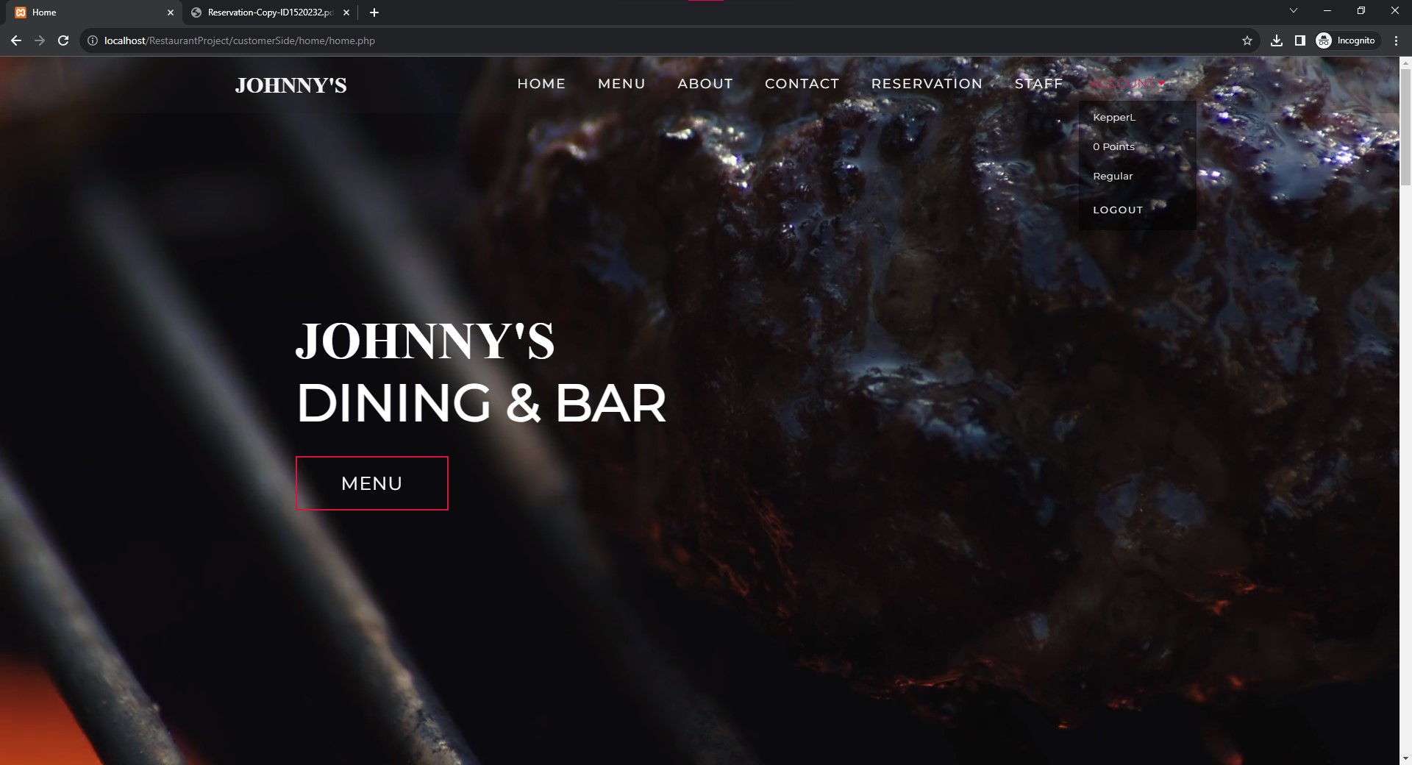
Code inspection results:

Slide 21
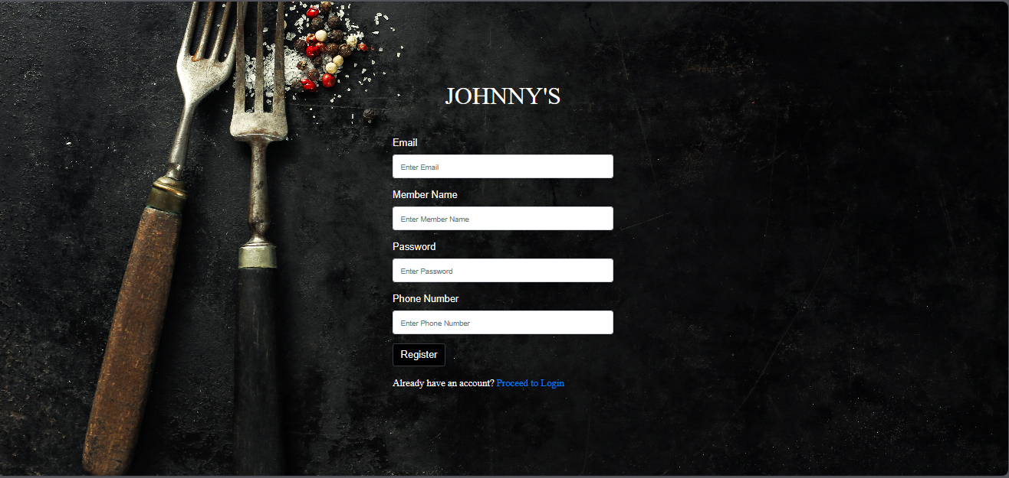
Code inspection results:

Slide 22
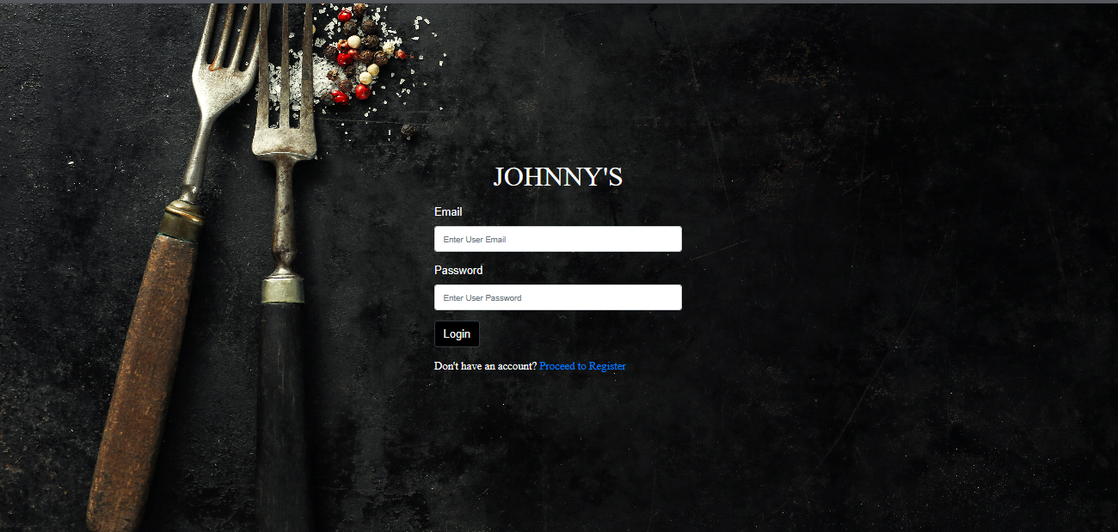
Code inspection results:

Slide 23
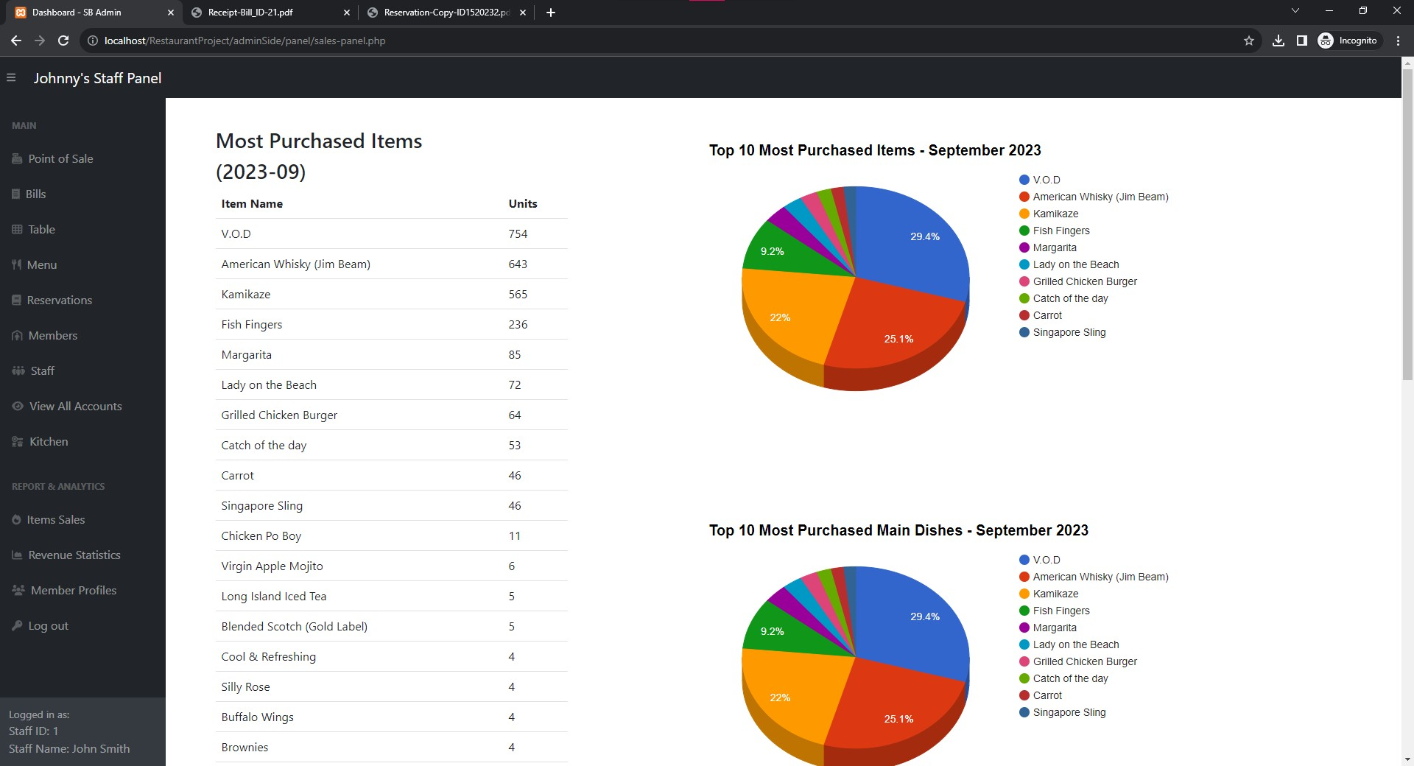

Slide 24
Limitations:
Limitations and Known Issues:
Inventory Alert Delays: There might be a delay in inventory alerts during peak usage times.
Profile Picture Upload: Currently, the profile picture upload feature is not supported.

Slide 25
Key Findings and Improvements:
Performance Optimization: Testing highlighted some areas where performance could be improved, particularly in inventory updates. Optimizations were made in database queries and server-side processing.
Usability Enhancements: User testing provided valuable feedback on the UI/UX, leading to several interface improvements for better navigation and accessibility.
Security Reinforcements: Security testing identified potential vulnerabilities, prompting enhancements in data encryption and user authentication processes.
QA Impact:
The rigorous testing methodologies have significantly contributed to the reliability and user-friendliness of DineSys.
Continuous testing and quality assurance have become integral to our development cycle, ensuring high standards are maintained.

Slide 26
Challenges and Solutions
Significant Challenges Faced:
Integration Complexity:
Early stages of integrating different system components led to unexpected issues, particularly in synchronizing the frontend and backend.
Performance Optimization:
Initial prototypes experienced performance lags during high-volume transactions, especially in inventory management and order processing.
Adapting to User Feedback:
Incorporating user feedback into an already complex system proved challenging, particularly in terms of UI/UX adjustments.
Overcoming These Challenges:
Robust Testing and Debugging:
Implemented rigorous testing protocols, including end-to-end testing, to identify and resolve integration issues.
Performance Tuning:
Optimized database queries and server-side code to enhance system performance.
Employed caching strategies to reduce load times.
Iterative Design Approach:
Adopted an agile methodology, allowing for flexible and rapid incorporation of user feedback into the design and functionalities.

Slide 27
Conclusion
Summing Up: The DineSys Story
Innovative Solution: DineSys stands as a testament to innovative solutions in restaurant management, integrating technology to enhance operational efficiency and customer satisfaction.
Team Effort: This journey was made possible through the dedicated efforts of a skilled and diverse team, committed to excellence and innovation.
Value Proposition: DineSys offers restaurants a comprehensive, user-friendly, and efficient way to manage their operations, adapt to market changes, and improve customer engagement.

Slide 28
References
Technical References:
PHP Documentation. (2023). PHP: Hypertext Preprocessor. Retrieved from https://www.php.net/docs.php
MySQL. (2023). MySQL Documentation. Retrieved from https://dev.mysql.com/doc/
W3Schools. (2023). HTML/CSS/JavaScript Tutorials. Retrieved from https://www.w3schools.com/
UI/UX Design Inspiration:
Nielsen, J., & Norman, D. (2023). Nielsen Norman Group: Evidence-Based User Experience Research. Retrieved from https://www.nngroup.com/
Adobe XD Ideas. (2023). Design Inspiration and Trends. Retrieved from https://xd.adobe.com/ideas/
Project Management and Agile Methodology:
Schwaber, K., & Sutherland, J. (2023). The Scrum Guide. Retrieved from https://www.scrumguides.org/
Atlassian. (2023). Agile Project Management. Retrieved from https://www.atlassian.com/agile
Testing Frameworks and Tools:
PHPUnit. (2023). PHPUnit Manual. Retrieved from https://phpunit.de/manual/
Jasmine. (2023). Jasmine JavaScript Testing Framework. Retrieved from https://jasmine.github.io/
Academic and Research Sources:
[Provide any academic papers, journals, or research articles that were referred to during the project.]
Special Acknowledgements:
We would like to extend our gratitude to [Mentors, Advisors, Contributors] for their guidance and insights throughout the project.
A special thank you to [Any Organizations, Communities, or Forums] for their support and resources.

